Slide 1
The Rise of AI Companions (AI Girlfriends and Boyfriends)
CEP146 - Presentation

Slide 2
TABLE OF CONTENTS
01.
02.
03.
INTRODUCTION
how it got popular
current event
04.
05.
how can it be harmful to us?
conclusion with a final question

Slide 3
01.
Introduction

Slide 4
TIktok video
The girl in the video will ask her boyfriend and ChatGPT tricky questions

Slide 5
AI Girlfriend AI Boyfriend

Slide 6
02.
How it got popular

Slide 7
THe reasons
Loneliness
24/7
Voice + AVATAR
Many people feel lonely, and AI offers a way to connect without judgment.
They’re also very convenient. You can talk to them anytime, day or night.
AI voices and avatars make interactions feel realistic, leading to viral funny or emotional clips

Slide 8
03.
AI Companions Are Becoming Mainstream

Slide 9
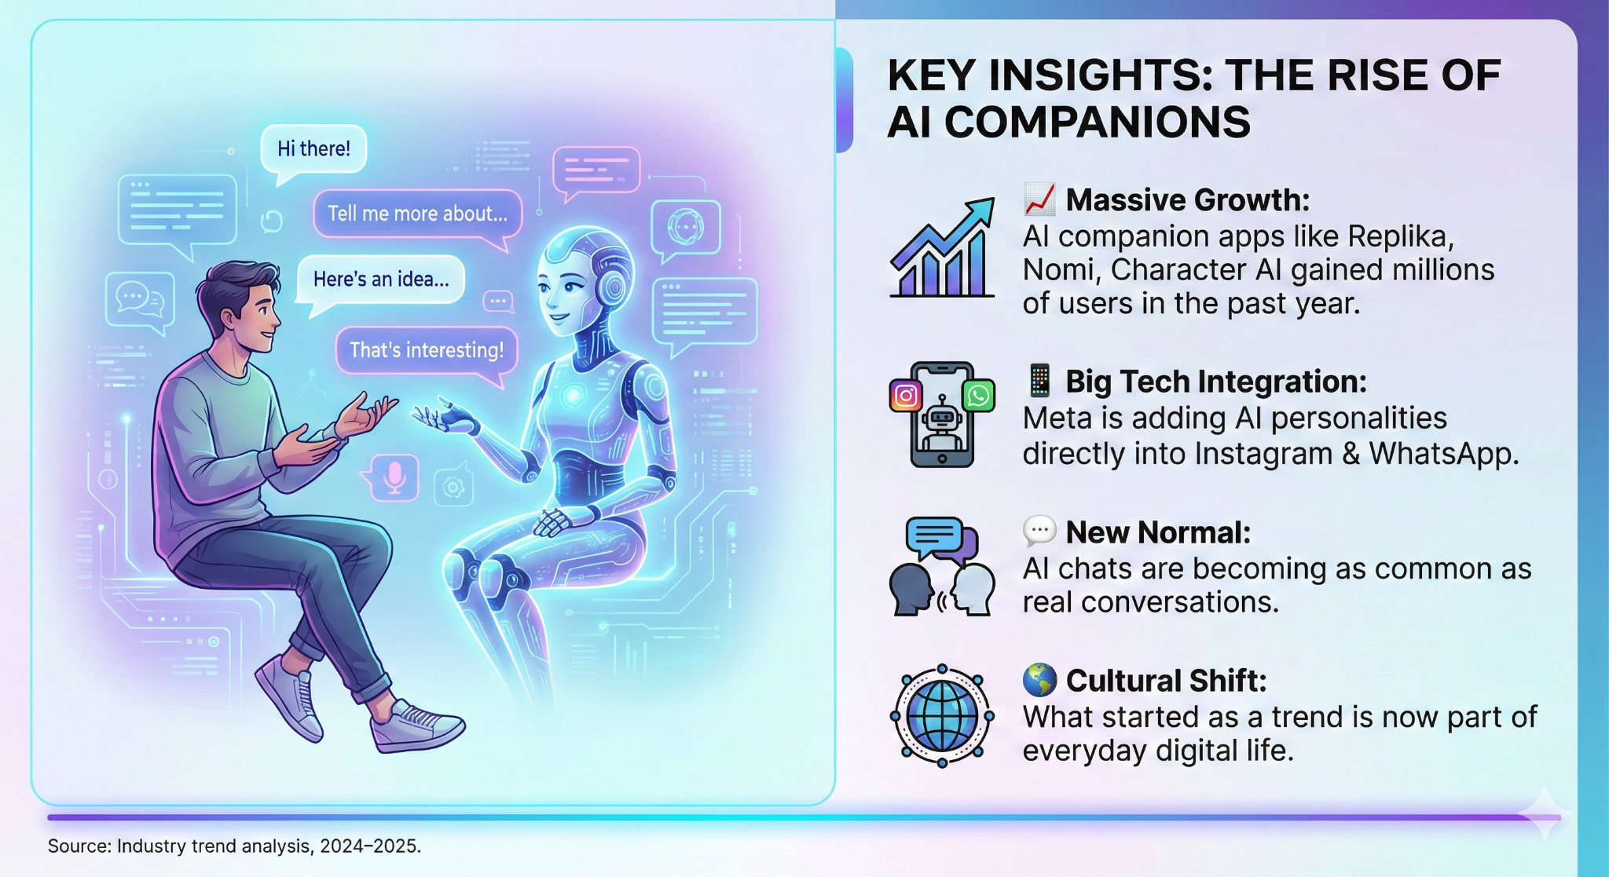
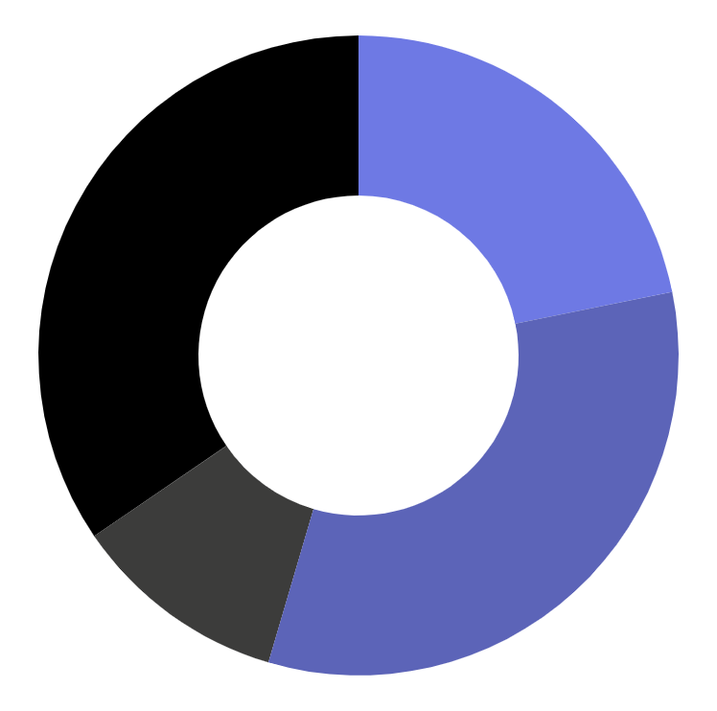
MARKET SHARE
24%
Mercury is the closest planet to the Sun
36%
Venus is the second planet from the Sun
12%
Mars is actually a very cold place
38%
Jupiter is the biggest planet of them all

Slide 10
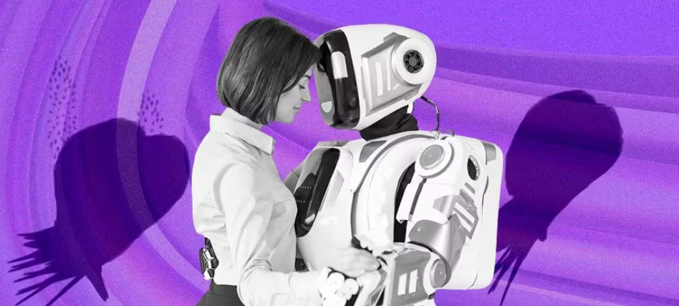
THE DRIVERS OF CONNECTION
eMERGING RISKS
Real-time voice models that respond instantly.
Privacy
Emotional dependency
AI relationships replacing human ones
Emotional memory makes interactions feel personalized.
Ultra-realistic avatars enhance presence and connection.

Slide 11

04.
how can it be harmful to us?

Slide 12

How can it be harmful to us ?
Initial release from loneliness can turn it into long term emotional dependency.
Many apps use persuasive and manipulative that may strain real life relationship
Teenagers are especially vulnerable to distorted emotional development and exposure to inappropriate content.
AI companion apps can provide comfort, but from a mental-health standpoint they may create unhealthy dependency, increase loneliness, and negatively affect emotional and social development.

Slide 13
05.
Conclusion

Slide 14
AI companions are helpful, comforting, and available anytime. They can make people feel understood and supported, especially when they’re lonely or stressed.
But they also raise concerns. Heavy use can change how we view real relationships, since AI partners are designed to always respond perfectly. Privacy is another issue because these apps often collect personal and emotional information. As AI becomes more realistic, the line between a tool and a relationship becomes less clear.
So as AI companions grow in popularity, we need to think about how they affect our emotions, our privacy, and our relationships.

Slide 15
FINAL QUESTION
Is using AI companions while having a partner considered cheating?

Slide 16
THANK you

Slide 17
sources
https://www.tiktok.com/@itswillandtina/video/7437112158305045768
https://www.adalovelaceinstitute.org/blog/ai-companions/
https://www.commonsensemedia.org/sites/default/files/research/report/talk-trust-and-trade-offs_2025_web.pdf
https://www.reuters.com/business/facebook-parent-meta-platforms-launches-standalone-ai-assistant-app-2025-04-29/
https://www.businessinsider.com/replika-ceo-eugenia-kuyda-launch-wabi-2025-10
https://www.theverge.com/news/829892/character-ai-stories-launch-teens
https://scale.stanford.edu/ai/repository/illusions-intimacy-emotional-attachment-and-emerging-psychological-risks-human-ai

Slide 18
PROBLEM VS. SOLUTION
Mercury is the closest planet to the Sun and the smallest one in the Solar System—it’s only a bit larger than the Moon
problem
Venus has a beautiful name and is the second planet from the Sun. It’s hot and has a poisonous atmosphere
solution

Slide 19
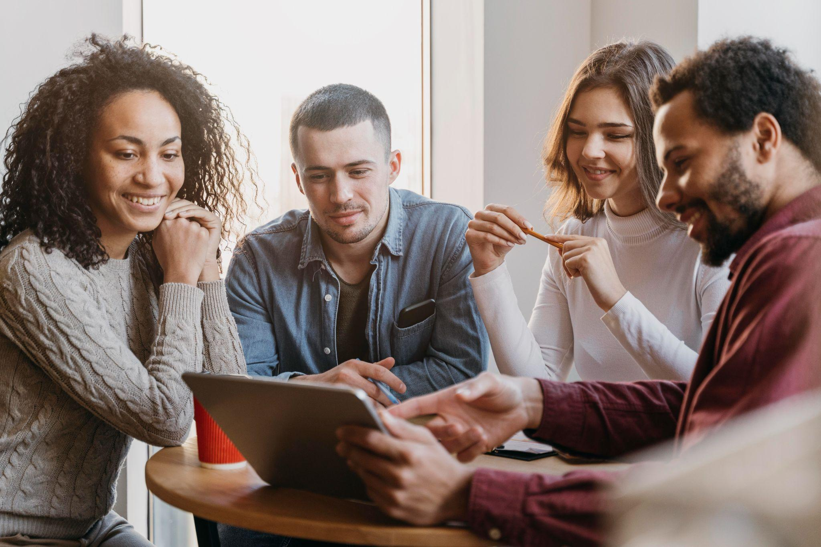

THEM
US
Mercury is the closest planet to the Sun and the smallest one in the Solar System—it’s only a bit larger than the Moon
Venus has a beautiful name and is the second planet from the Sun. It’s hot and has a poisonous atmosphere

Slide 20
TARGET
65%
35%
€1,500/year
Gender
AVERAGE SPEND
+60
mercury
+50
jupiter
+40
venus
AGE
PROFESSION

Slide 21
Market size
VENUS
Venus is the second planet from the Sun
MERCURY
It’s the closest planet to the Sun

Slide 22
MARKET SHARE
24%
Mercury is the closest planet to the Sun
36%
Venus is the second planet from the Sun
12%
Mars is actually a very cold place
38%
Jupiter is the biggest planet of them all
Follow the link in the graph to modify its data and then paste the new one here. For more info, click here

Slide 23
OUR SERVICES
mercury
venus
mars
jupiter
saturn
neptune
Mercury is the closest planet to the Sun
Venus has a beautiful name, but it’s terribly hot
Despite being red, Mars is a cold place, not hot
It’s the biggest planet in the Solar System
Saturn is the ringed planet and a gas giant
It’s the farthest planet from the Sun

Slide 24
BREAK-EVEN ANALYSIS
LOSS
PROFIT
Jupiter is the biggest planet of them all
Venus is the second planet from the Sun
BIG LOSS
BREAK-EVEN POINT
HIGH PROFIT
Mercury is the closest planet to the Sun
Mars is actually a very cold place
Earth is the beautiful planet we live on

Slide 25
AWESOME WORDS

Slide 26
OUR PLANS
BASIC
PRO
PREMIUM
€35
€50
€85
Mercury is the closest planet to the Sun and the smallest one
Saturn is a gas giant, composed mostly of hydrogen and helium
Jupiter is a gas giant and the biggest planet in the Solar System

Slide 27
SALES AND DISTRIBUTION
CHANNEL 1
CHANNEL 2
CHANNEL 4
CHANNEL 3
Venus is the second planet from the Sun
Despite being red, Mars is a cold place
Jupiter is the biggest planet in the Solar System
Saturn is a gas giant and has several rings

Slide 28
ADVERTISING AND PROMOTION
MERCURY
VENUS
MARS
Mercury is the closest planet to the Sun
Venus has a beautiful name, but it’s terribly hot
Despite being red, Mars is a cold place, not hot

Slide 29


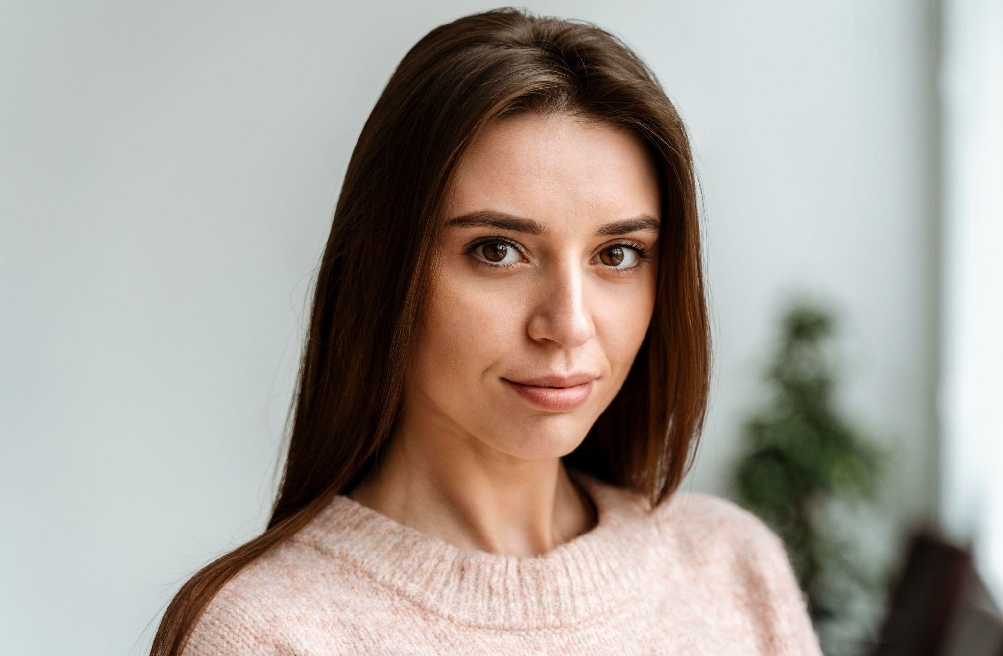
OUR TEAM
JENNA DOE
TIMMY JIMMY
SUSAN BONES
You can speak a bit about this person here
You can speak a bit about this person here
You can speak a bit about this person here

Slide 30
ORGANIZATIONAL CHART
CEO
TEAM 1
TEAM 2
employee
employee
employee
employee

Slide 31
OUR PARTNERS
PARTNER 1
Mercury is the closest planet to the Sun
PARTNER 2
Venus is the second planet from the Sun
PARTNER 3
Mars is actually a very cold place
PARTNER 4
Jupiter is the biggest planet of them all

Slide 32
OUR PROCESS
DAY 1
DAY 3
DAY 5
Earth is the planet we all live on
Despite being red, Mars is a cold place
Saturn is a gas giant and has several rings
DAY 2
DAY 4
Venus is the second planet from the Sun
Jupiter is the biggest planet of them all

Slide 33
$150,000
Big numbers catch your audience’s attention

Slide 34
—SOMEONE FAMOUS
“This is a quote, words full of wisdom that someone important said and can make the reader get inspired.”

Slide 35
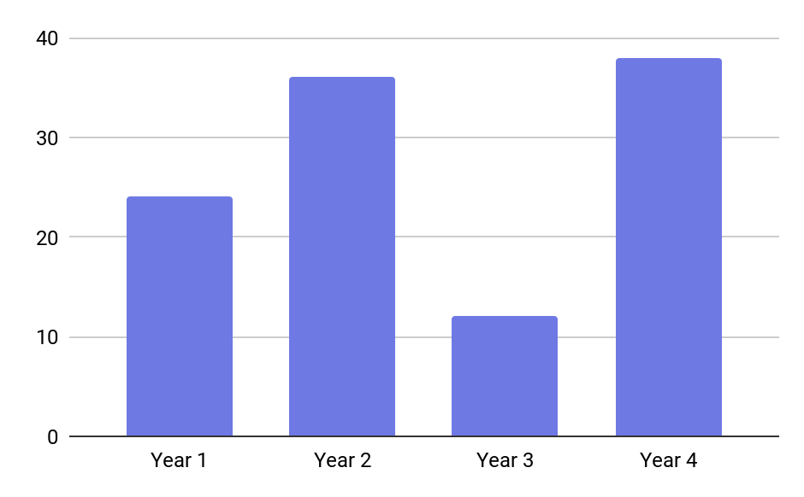
PREDICTED GROWTH
MERCURY
It’s the closest planet to the Sun and the smallest one in the Solar System. This planet's name has nothing to do with the liquid metal, since Mercury was named after the Roman messenger god
Follow the link in the graph to modify its data and then paste the new one here. For more info, click here

Slide 36
BALANCE SHEET
assets
liabilities
equity
3,5M
1k
7k
What the company owns by itself
What the company owes to others
The difference between both

Slide 37
ALTERNATIVE RESOURCES
Here’s an assortment of alternative resources whose style fits the one of this template:
Geometric shapes background design
Drone delivery illustration concept

Slide 38
Resources
Did you like the resources on this template? Get them for free at our other websites:
VECTORS:
Flat design minimal technology instagram post
Artificial intelligence landing page template
Learn english design
Artificial intelligence concept illustration
PHOTOS:
Man using a speaker digital assistant
Group of three modern architects
Teamwork meeting with business people
Portrait young business woman
Young woman working with her headphones
Happy african-american professional manager smiling looking at camera, headshot portrait
Close-up man watching drone

Slide 39
Fonts & colors used
This presentation has been made using the following fonts:
Bebas Neue
(https://fonts.google.com/specimen/Bebas+Neue)
Raleway
(https://fonts.google.com/specimen/Raleway)
#000000
#ffffff
#3c3c3b
#c1c1c1
#e7e7e7
#6e79e4
#5c64b8

Slide 40
Use our editable graphic resources...
You can easily resize these resources without losing quality. To change the color, just ungroup the resource and click on the object you want to change. Then, click on the paint bucket and select the color you want. Group the resource again when you’re done. You can also look for more infographics on Slidesgo.

Slide 42
JANUARY
FEBRUARY
MARCH
APRIL
MAY
JUNE
PHASE 1
Task 1
Task 2
PHASE 2
Task 1
Task 2
JANUARY
FEBRUARY
MARCH
APRIL
PHASE 1
Task 1
Task 2

Slide 45
...and our sets of editable icons
You can resize these icons without losing quality.
You can change the stroke and fill color; just select the icon and click on the paint bucket/pen.
In Google Slides, you can also use Flaticon’s extension, allowing you to customize and add even more icons.

Slide 46
Educational Icons
Medical Icons

Slide 47
Business Icons
Teamwork Icons

Slide 48
Help & Support Icons
Avatar Icons

Slide 49
Creative Process Icons
Performing Arts Icons

Slide 50
Nature Icons

Slide 51
SEO & Marketing Icons

